Slide 1
Mobile App for Direct Market Access for Farmers
PIP4004 University Project
Final Review
Batch Number: CSG G 6
14-05-2025
Under the Supervision of,
Mr. Lakshmisha S Krishna
Assistant Professor
School of Computer Science and Engineering
Presidency University
Roll Number | Student Name
20211CSG0030 | G Nithin
20211CSG0012 | Jayanth V
20211CSG0034 | Swaroop R S
20221LCG0003 | Lohith M C
Name of the Program: B.Tech Computer Science and Technology
Name of the HoD: Dr. Saira Banu Atham
Name of the Program Project Coordinator: Dr. Manjula H M
Name of the School Project Coordinators: Dr. Sampath A K / Dr. Abdul Khadar A / Mr. Md Ziaur Rahman

Slide 2
Content
Problem Statement
Github Link
Analysis of Problem Statement
Timeline of the Project
References

Slide 3
Problem Statement Number: PSCS_342
Organization: Ministry of Agriculture and Farmers Welfare
Category (Hardware / Software / Both) : Software
Problem Description: Background: Farmers often face challenges in accessing markets, leading to lower income due to middlemen. This gap restricts their ability to sell produce at fair prices. Description: Create a mobile application that connects farmers directly with consumers and retailers. The app should include features for listing produce, negotiating prices, and managing transactions, thereby reducing dependence on intermediaries. Expected Solution: A user-friendly mobile platform that enables farmers to showcase their
products and connect with buyers directly, enhancing their income potential.
Difficulty Level: Complex

Slide 4
Github Link
The Github link provided should have public access permission.
Github Link

Slide 5
Analysis of Problem Statement
Technology Stack Components:
Frontend: React.js
Backend: Node.js with Python
Database: MYSQL
Version Control: Git & GitHub

Slide 6
Analysis of Problem Statement (contd...)
Software and Hardware Requirements:
Software Requirements
Operating System: Windows 11
Development Tools: VS Code
Database Management: MYSQL
Libraries & Frameworks: React.js
Virtualization (Optional): Docker for containerization
Hardware Requirements
Processor: Intel Core i5/i7 or AMD Ryzen 5/7

Slide 7
Analysis of Problem Statement (contd...)
Farmers face challenges in accessing markets, relying on middlemen who take a significant cut, leading to lower income. Limited market access and lack of price transparency restrict their ability to sell produce at fair prices.
Challenges Faced by Farmers:
Dependency on middlemen for selling produce Unfair pricing and lack of direct negotiations Difficulty in reaching potential buyers Lack of digital payment solutions in rural areas
Proposed Solution:
A mobile application that enables farmers to directly connect with consumers and retailers, ensuring better profits and eliminating unnecessary intermediaries Produce Listing: Farmers can showcase their products. Price Negotiation: Direct communication between buyers and sellers. Wallet System: Secure transactions without middlemen.

Slide 8
RESEARCH GAPS OF EXISTING METHODS
Limitations in User Accessibility
Incomplete Integration of AI/ML Tools
Transaction Security and Trust Issues
Scalability and Infrastructure Challenges
Need for Multidisciplinary Approaches

Slide 9
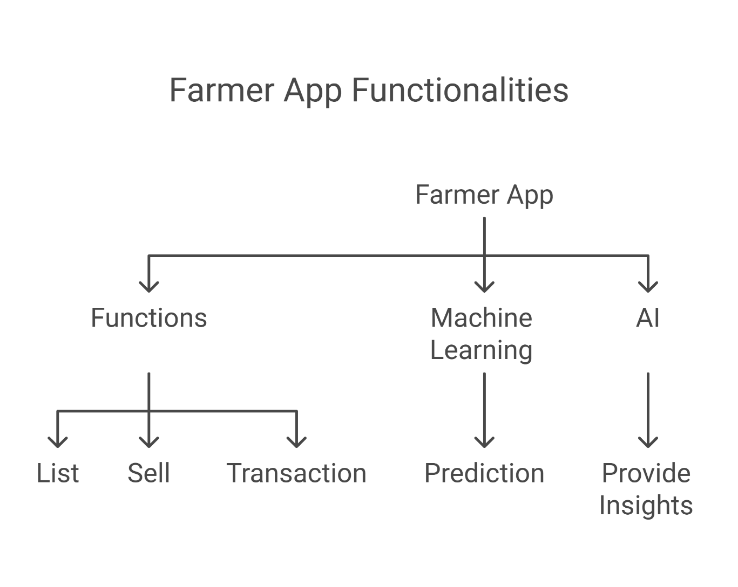
Proposed Methodology of the System

Slide 10
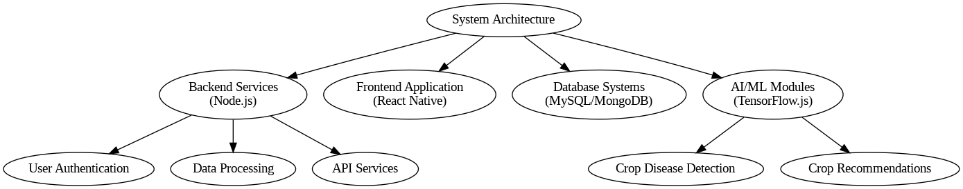

Slide 11
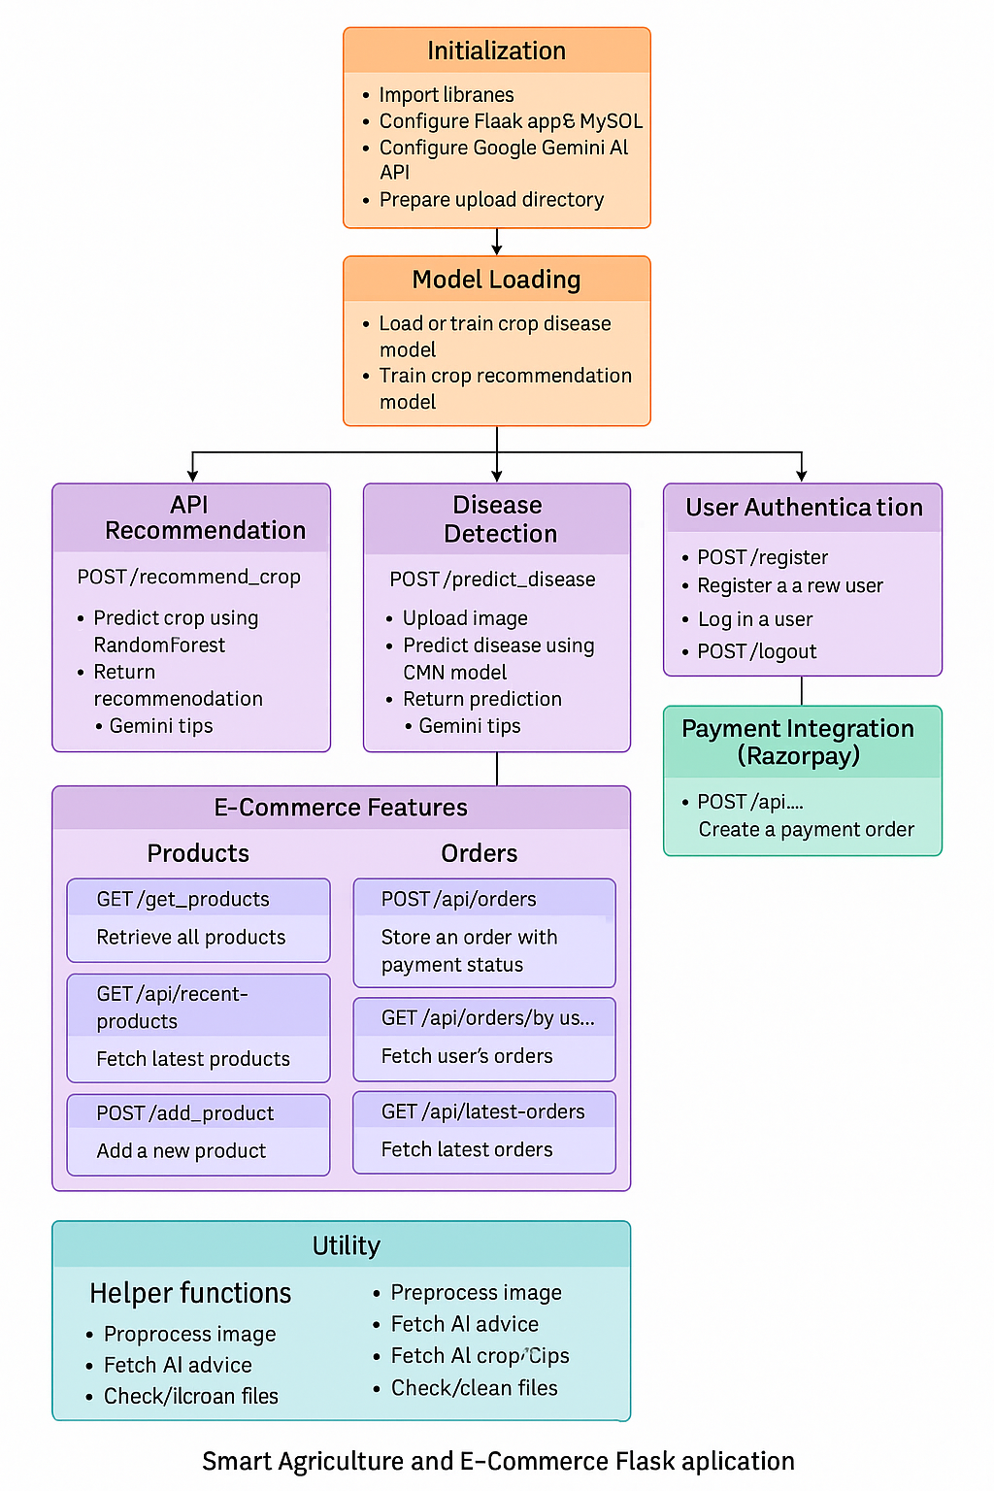

Slide 12
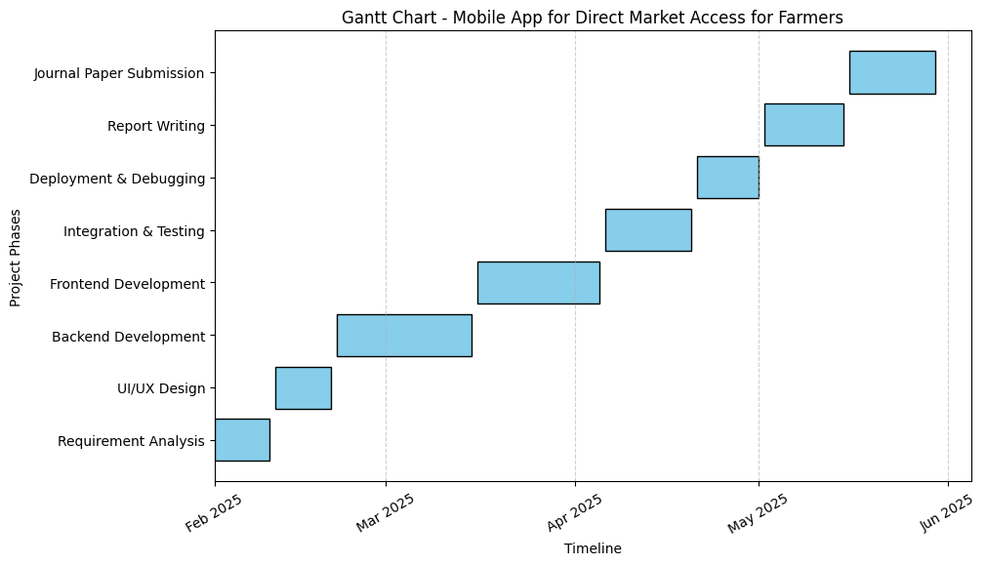
Timeline of the Project (Gantt Chart)

Slide 13
References (IEEE Paper format)
1. Farm Connect Application: Bridging the Gap Between Farmers and Consumers Through Digital Technology https://ieeexplore.ieee.org/document/10303471
2. Direct Market Access for Farmers https://ijcrt.org/papers/IJCRT2412239.pdf
3. Machine Learning for Detection and Prediction of Crop Diseases and Pests https://www.mdpi.com/2077-0472/12/9/1350
4. Farmers E-Commerce Mobile Application https://ijcrt.org/papers/IJCRT2403320.pdf
5. Crop Disease Prediction Using Machine Learning and Deep Learning: An Exploratory Study https://ieeexplore.ieee.org/document/10169612
6. Development of Web-Based System for Farmer to Consumer Product Selling - https://ijcrt.org/papers/IJCRT2003308.pdf
7. Plant Disease Detection Using Machine Learning https://ieeexplore.ieee.org/document/8437085
8. Mobile App for Direct Market Access https://www.jetir.org/papers/JETIR2412104.pdf
9. AI-Powered Predictive Analysis for Pest and Disease Forecasting in Crops - https://ieeexplore.ieee.org/document/10421237
10. Development of a Mobile Application for Connecting Farmers with Traders https://www.sciencedirect.com/science/article/pii/S2352711021001234

Slide 14


